Slide 1
Optimisers Introduction
Dr. U. Michelucci (TOELT)

Slide 2
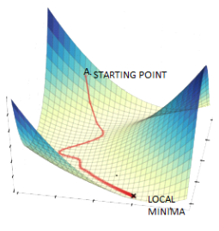
Gradient Descent
Image source: https://www.datasciencecentral.com/alternatives-to-the-gradient-descent-algorithm/, Accessed on 20/8/2022

Slide 3
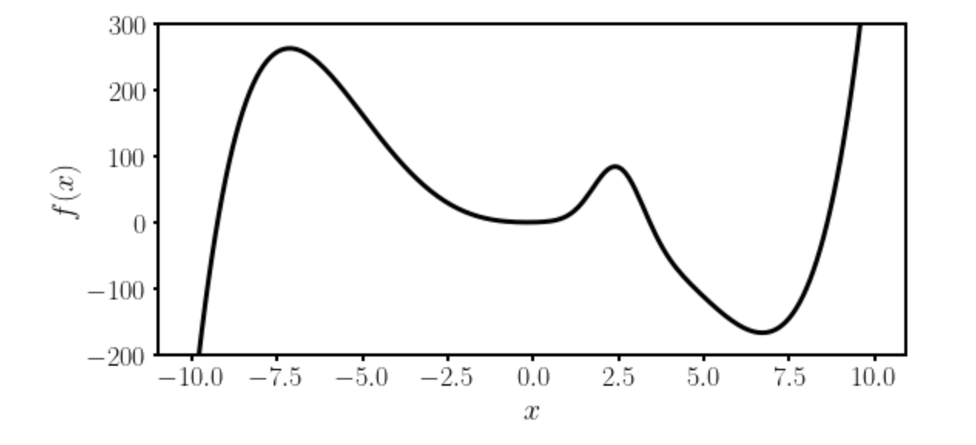
Gradient Descent I
Local minimum
Absolute minimum
Let’s suppose we want to find the absolute minimum of a given function $f(x)$.

Slide 4
Gradient Descent II
There is no analytical solution to the position of the absolute minimum for a network function.
Thus numerical methods are required.

Slide 5
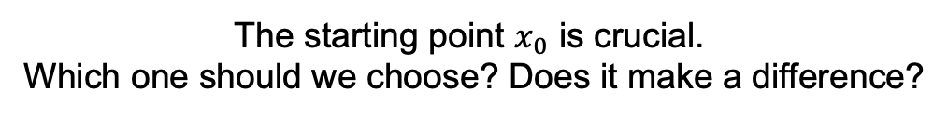

Gradient Descent III
The most used method is called Gradient Descent and uses the following formula (in 1-Dimension)
$$x_{n+1}→x_{n}−γ \frac{df}{dx}(x_{n})$$
Slope of the
function to be
minimized
New minimum location
approximation
Previous minimum location
approximation
Learning rate
The starting point $x_{0}$ is crucial.
Which one should we choose? Does it make a difference?

Slide 6

Gradient Descent IV
Update slow (slope is near zero)
Very fast update
Slope of the
function to be
minimized
$$x_{n+1}→x_{n}−γ \frac{df}{dx}(x_{n})$$

Slide 7
Some remarks about gradient descent
To use gradient descent you will need the derivative (or gradient in multiple dimensions) of the function you want to minimize.
Due to this reason methods as autodifferentiations and back-propagations have been developed to be able to calculate the derivative of a generic network function.
→ Gradient descent is not the most efficient way of finding minima. It gets easily stuck in local minima. More advanced optimisers have been developed and are typically used (see Adam).

Slide 8
First challenge: the right learning rate
https://www.benfrederickson.com/numerical-optimization/

Slide 9
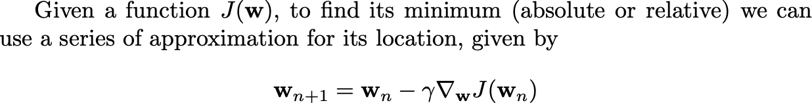
Gradient Descent in many dimensions
For those of you with more mathematical and programming background here is an implementation from scratch of the gradient descent: http://adl.toelt.ai/gradientDescent/Gradient_descent_developed_from_scratch.html

Slide 10
Optimizers
Gradient Descent
RMSProp
Adam
And many others…

Slide 11
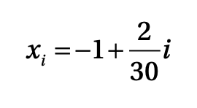
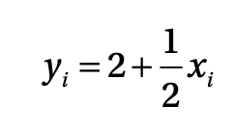

Toy Problem
Let us consider 30 tuples generated by
The goal of the problem is, starting from the 30 data points, to determine the linear relationships between x_{i} and y_{i}.
The optimizers will try to minimize the MSE with respect to w₀ and w₁.

Slide 12
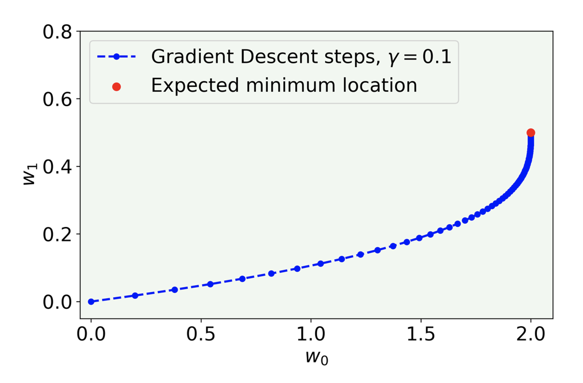
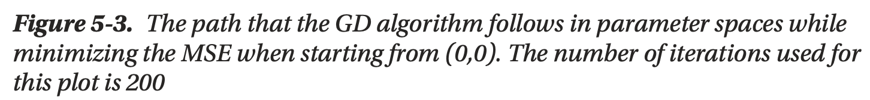
Comparison of algorithms in 2D
U. Michelucci, Applied Deep Learning with TensorFlow 2, Springer Nature, 2022

Slide 13
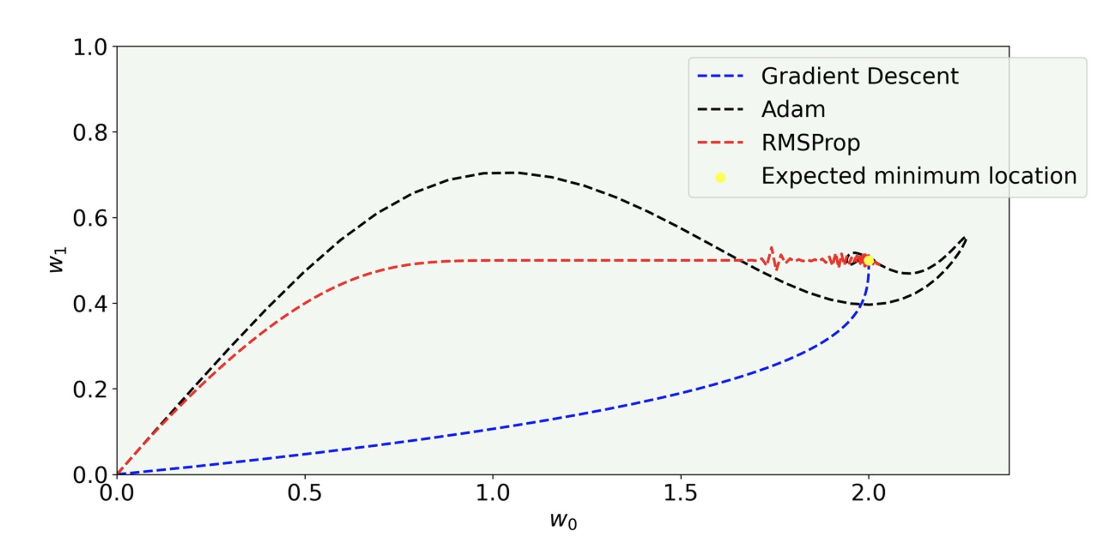
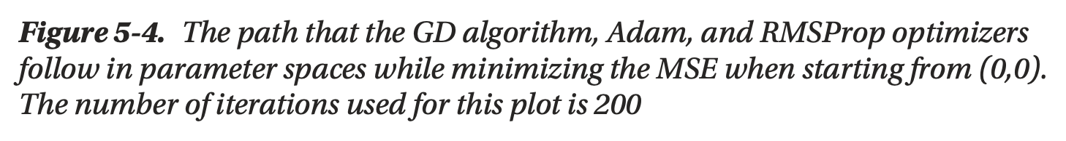
Comparison of algorithms in 2D
U. Michelucci, Applied Deep Learning with TensorFlow 2, Springer Nature, 2022

Slide 14
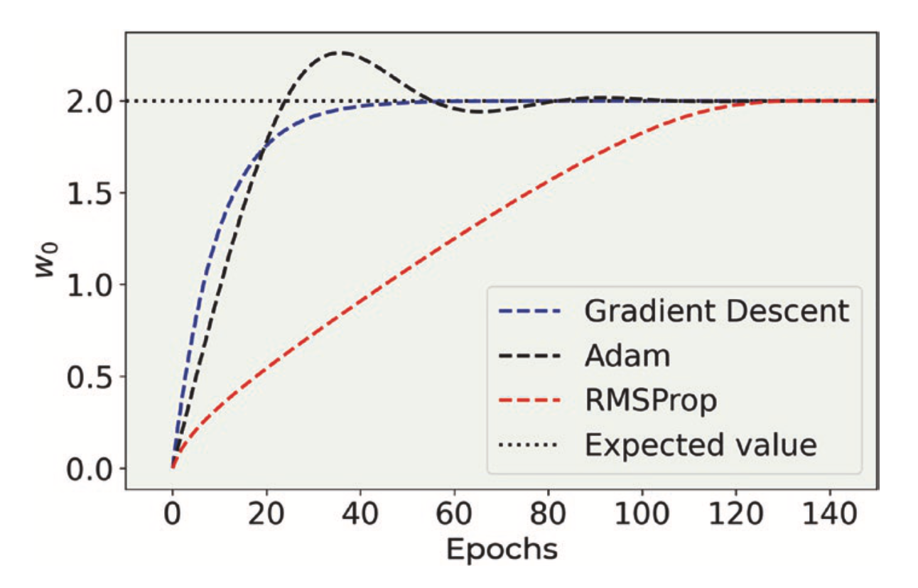
Comparison of algorithms in 2D
U. Michelucci, Applied Deep Learning with TensorFlow 2, Springer Nature, 2022

Slide 15
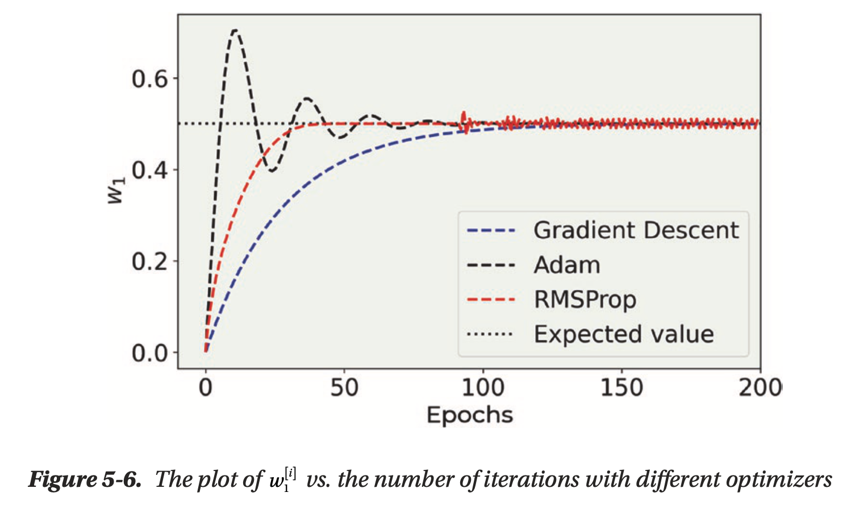
Comparison of algorithms in 2D
U. Michelucci, Applied Deep Learning with TensorFlow 2, Springer Nature, 2022

Slide 16
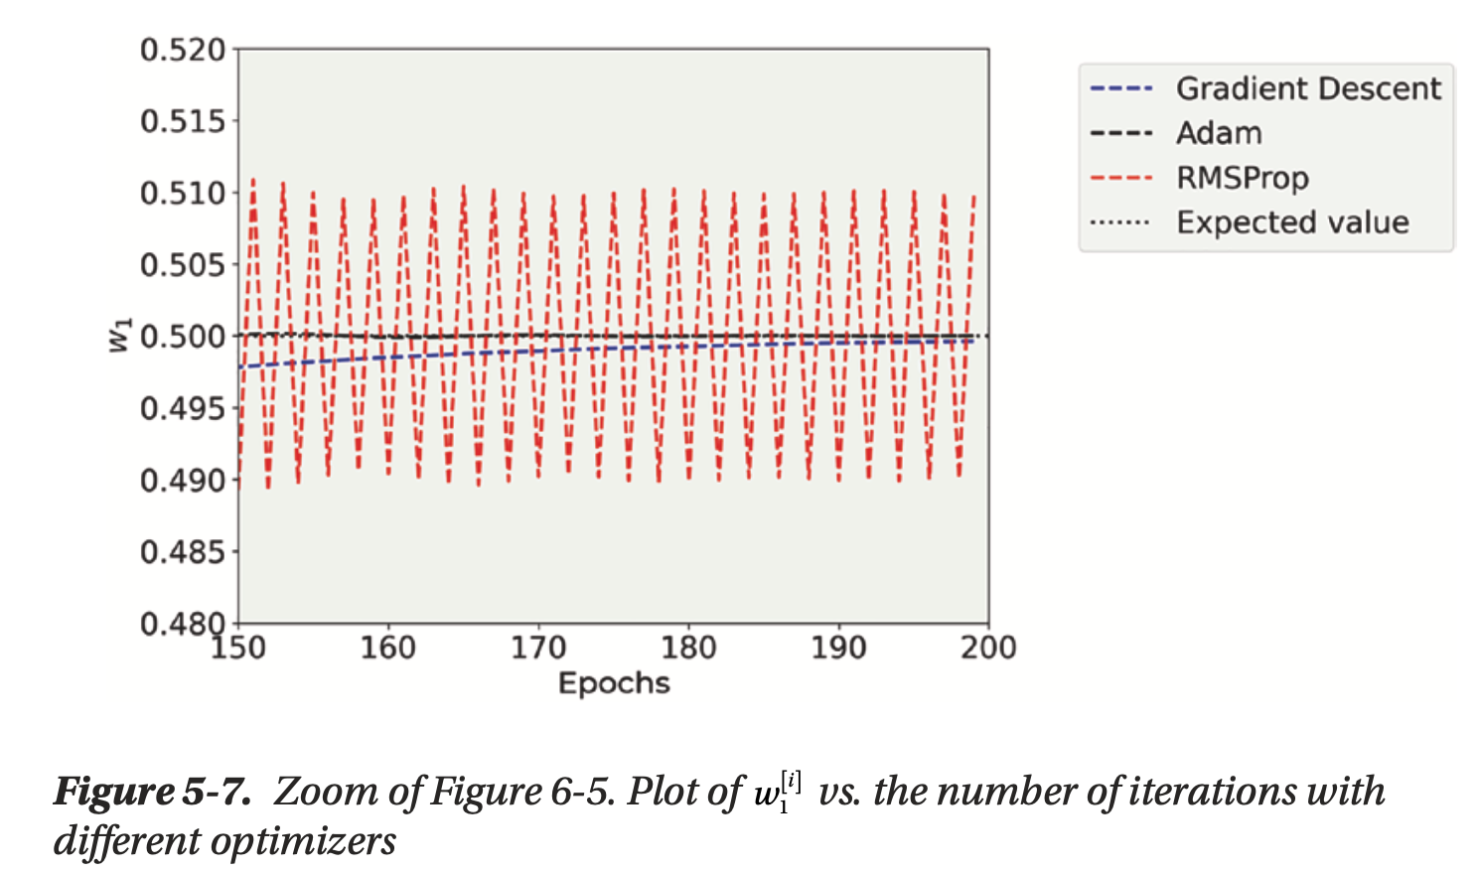
Comparison of algorithms in 2D
U. Michelucci, Applied Deep Learning with TensorFlow 2, Springer Nature, 2022

Slide 17
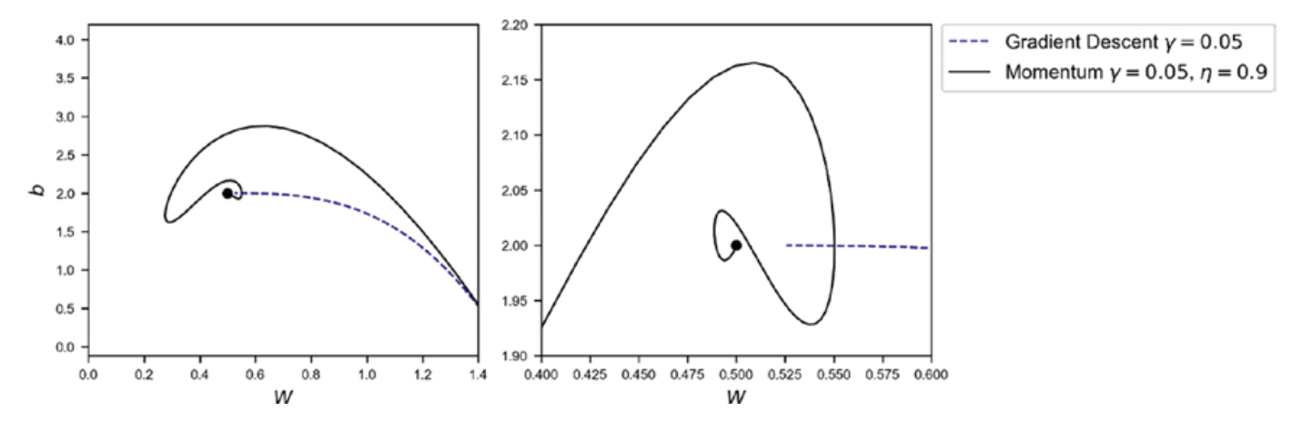
Comparison of algorithms in 2D
Source:Umberto Michelucci, Applied Deep Learning - A Case-Based Approach to Understanding Deep Neural Networks, APRESS 2018

